Slide 1
Competitive Programming
22 Sep. 2023
Andrei Novikov

Slide 2
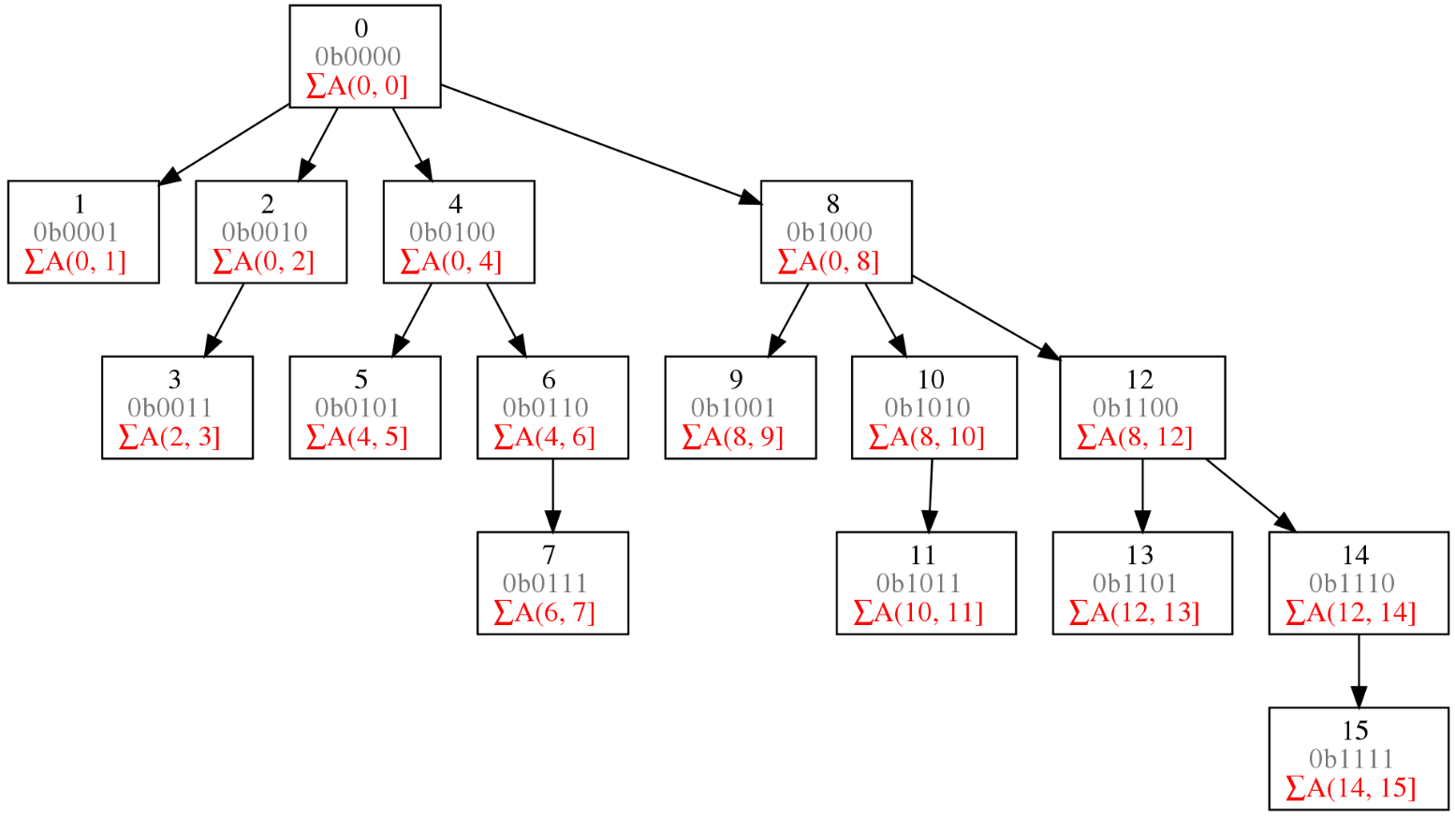
Previous Topic - Binary Indexed Tree
Create from array: O(N)
Update: O(log(N))
Count range sum: O(log(N))

Slide 3
Where to read about Binary Indexed Tree?
Competitive Programming 4
Chapter 4. Chapter 2.4.3.

Slide 4
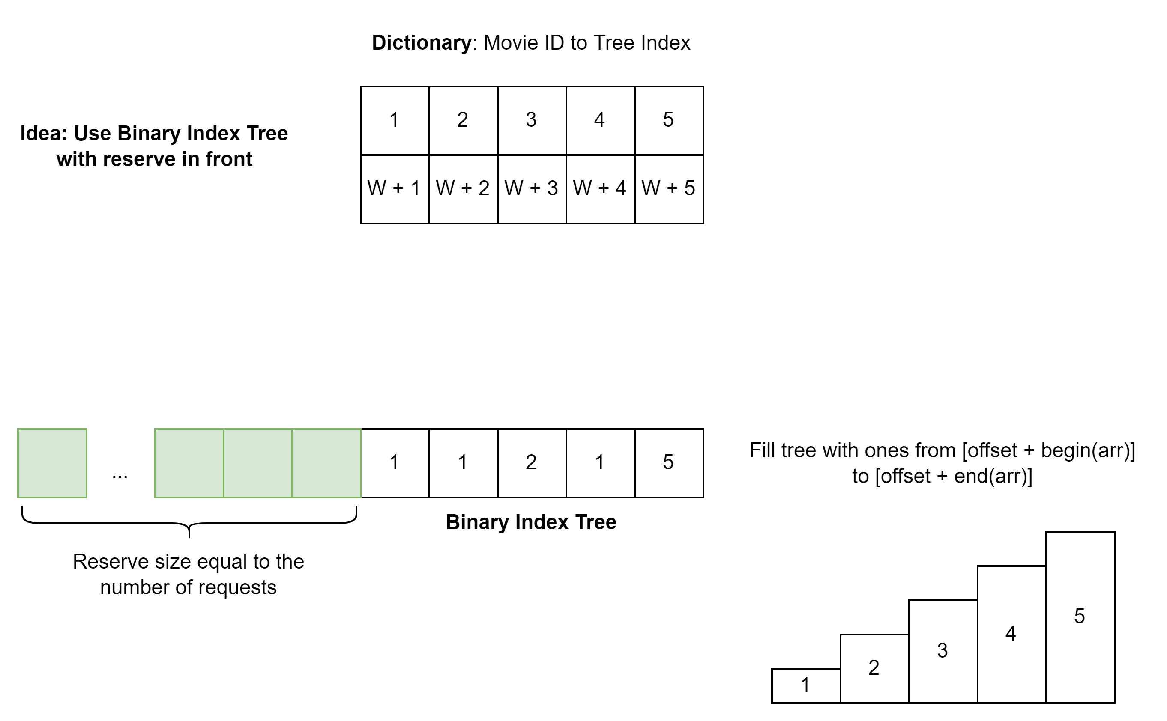
Previous Hometask
The aim of the hometask is to practice usage of Binary Indexed Tree.
Kattis – Movie Collection – Link
Tips and Hints
Use Binary Indexed Tree to count elements in front of it – O(log(N))
Use dictionary (array) to map movie ID to its position in the tree – O(1)
Reserve memory in front of the tree to move elements – O(log(N))

Slide 5
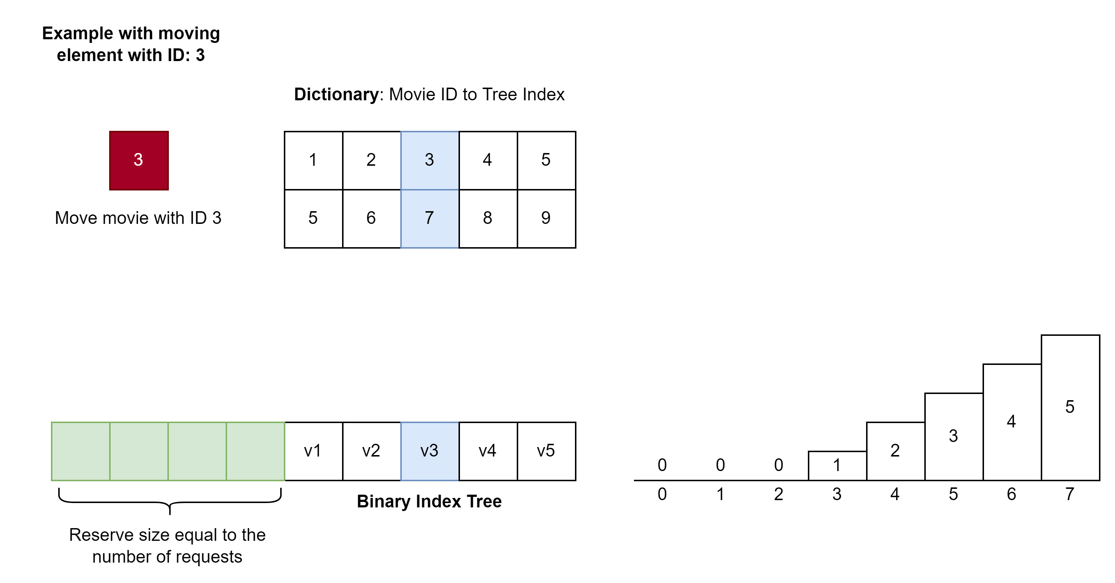
Previous Hometask
The aim of the hometask is to practice usage of Binary Indexed Tree.
Kattis – Movie Collection – Link
Example to move movie with ID: 3

Slide 6
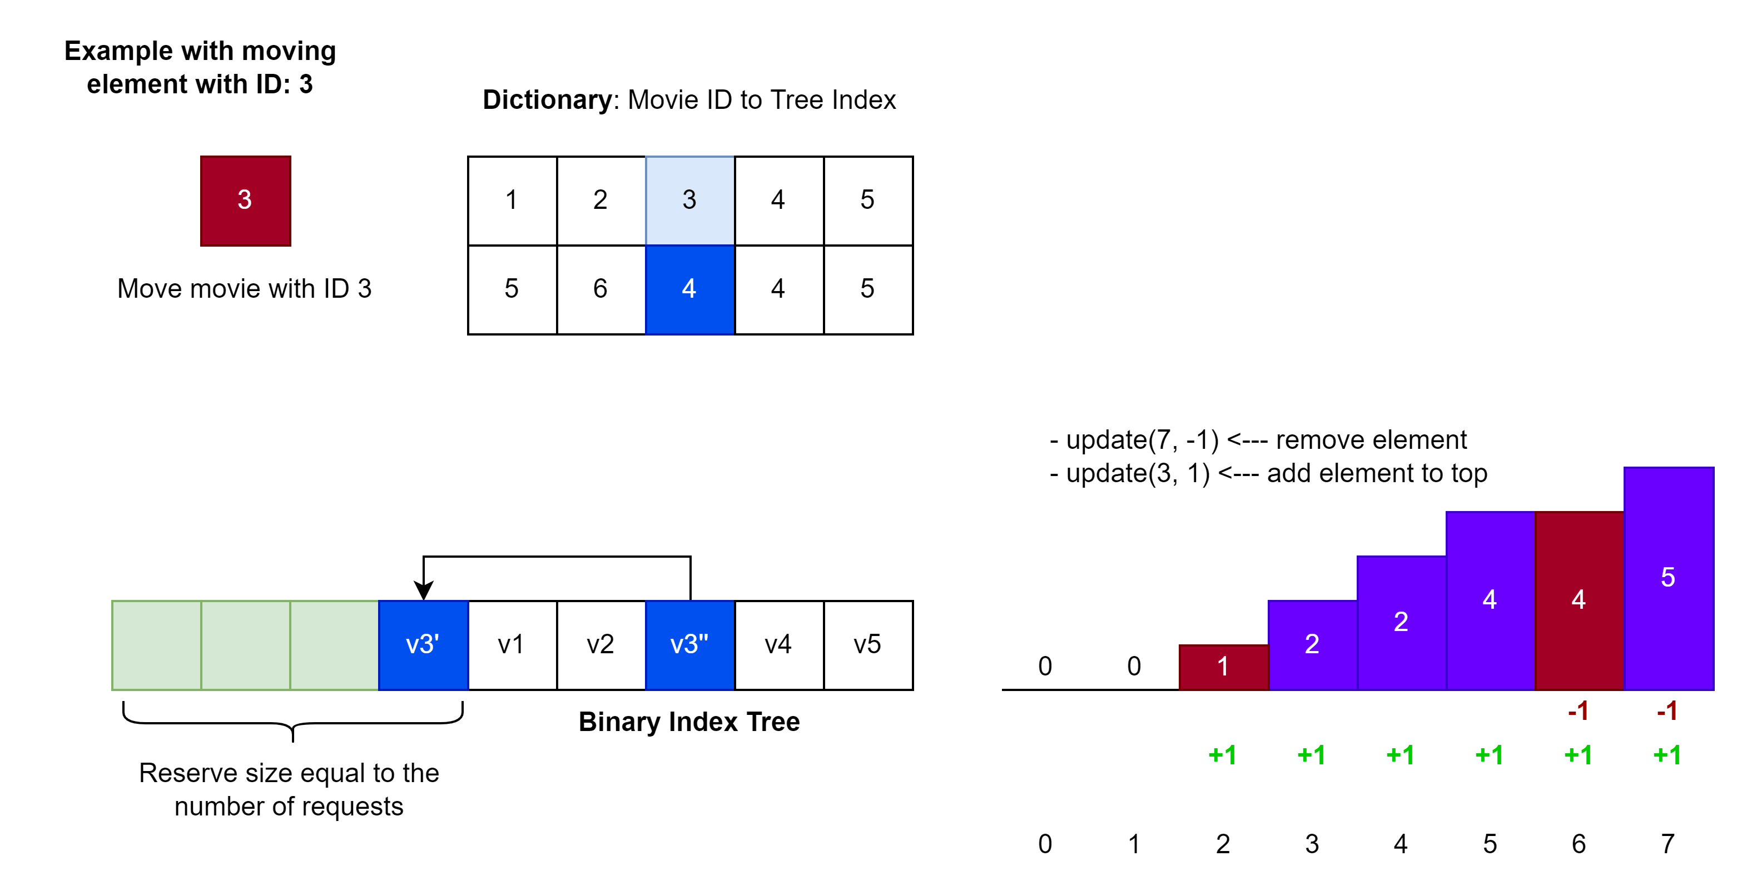
Previous Hometask
The aim of the hometask is to practice usage of Binary Indexed Tree.
Kattis – Movie Collection – Link
Example to move movie with ID: 3

Slide 7
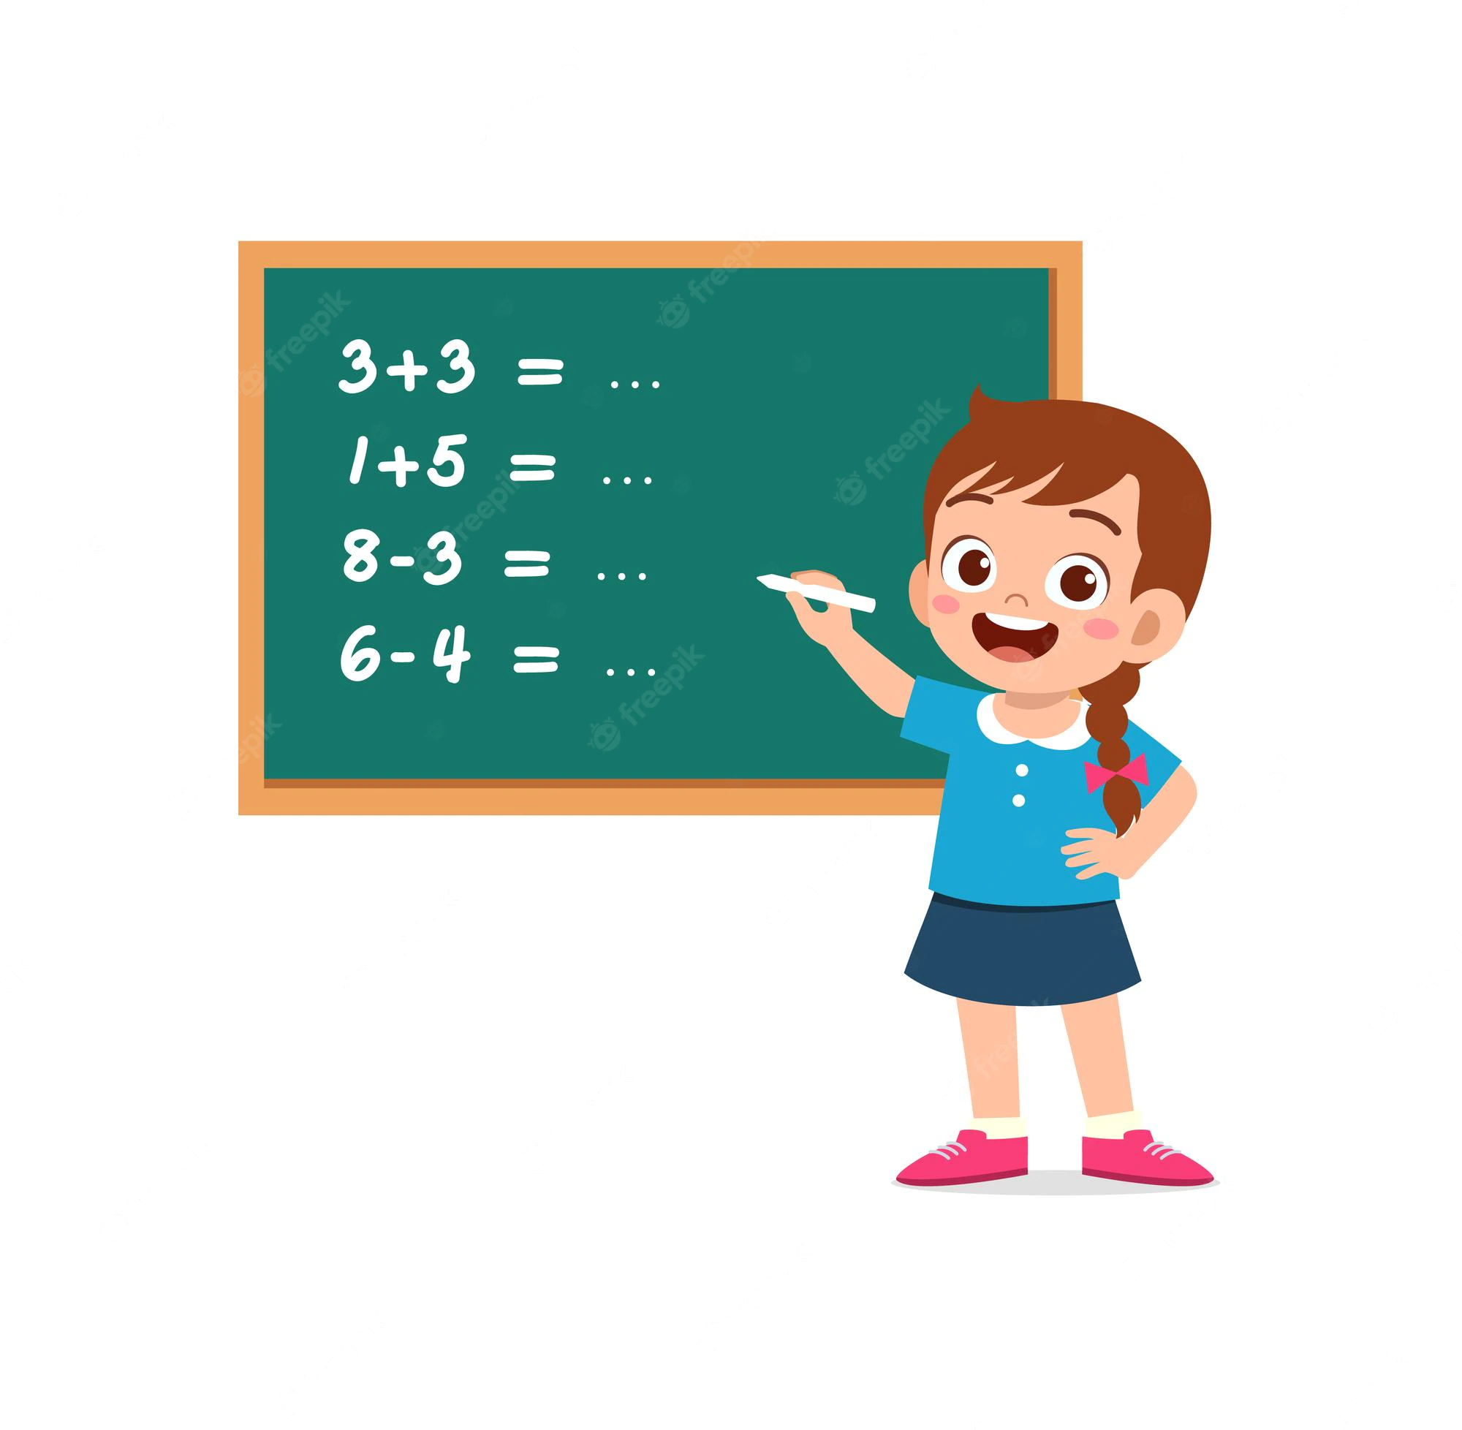
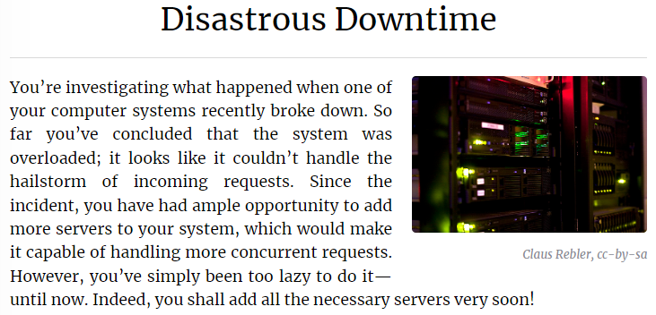
Practice – Binary Indexed Tree
Solve the problem:
Kattis. Disastrous Downtime – Link

Slide 8
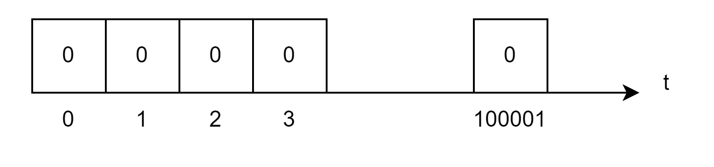
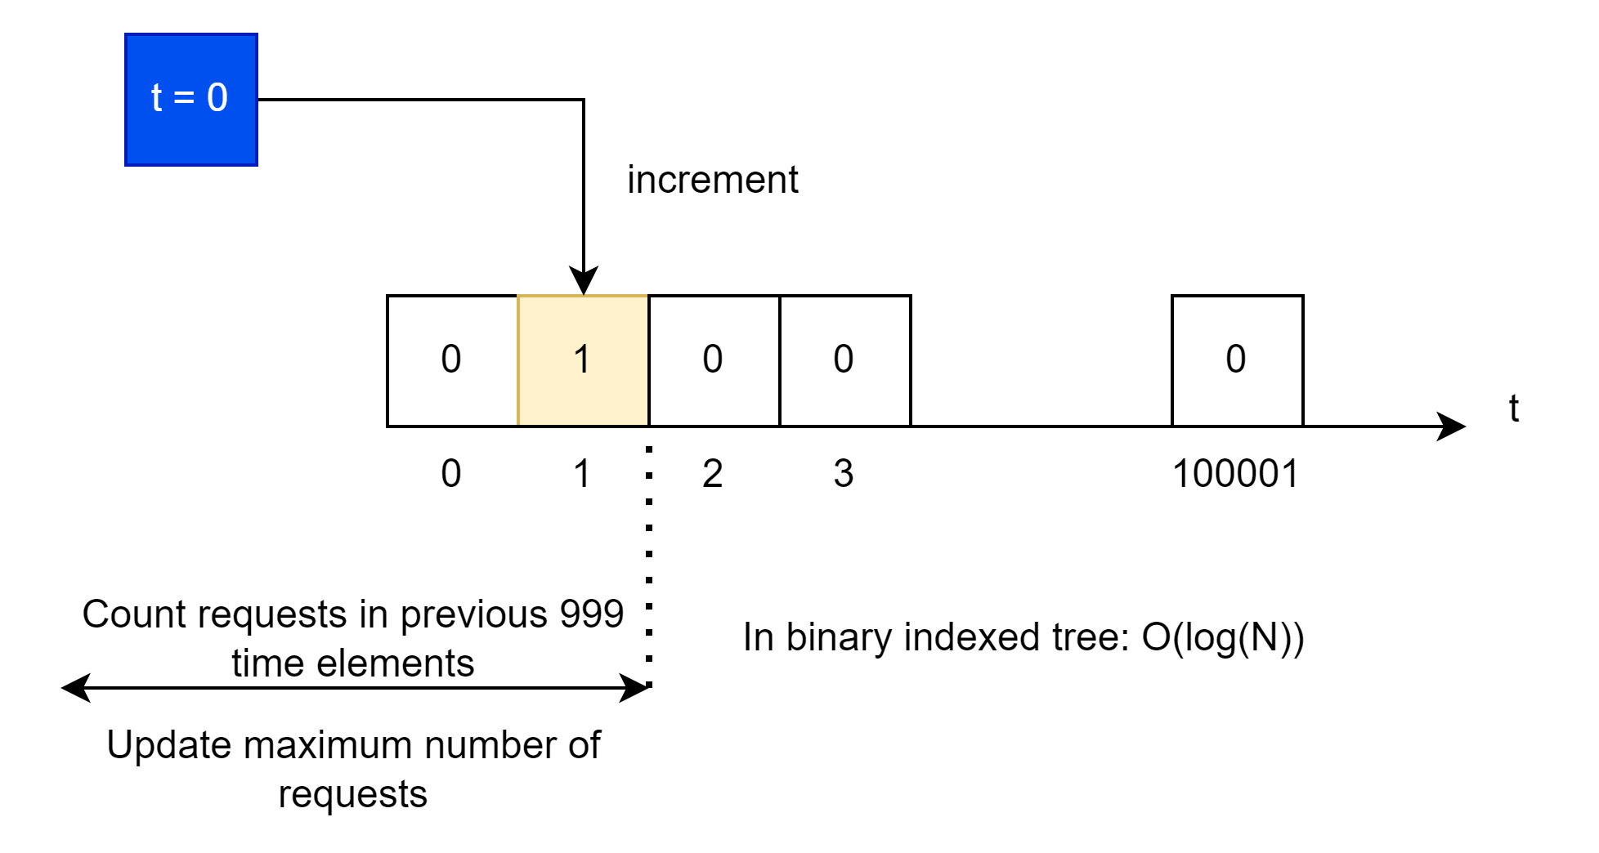
Practice – Binary Indexed Tree - Approach
Kattis. Disastrous Downtime – Link
Fenwick tree elements are timepoints, where each element contains the number of requests
When we need to add new request:
Add request i at time t_i.
Count sum between (i - 1000, i).
Update maximum number of requests (pike).

Slide 9
Hometask
Kattis. Turbo – Link
Topic: Fenwick Tree (Binary Indexed Tree)
Tips and Hints
Reserve memory in the front of the tree and at the back of the tree.
Place initial array in the middle of tree.
Move elements to beginning of the tree or to the end.
Count elements from current element position to its new place (log(N)).

Slide 10
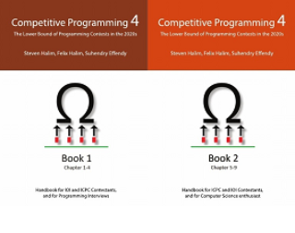
How to Learn and Practice
As one of the recommendation is to use:
Book Competitive Programming 4
Kattis – Link
Online Judge – Link
LeetCode - Link
Few Theory
A Lot of Practice
A Lot of Theory
Almost No Practice

